Slide 1


The European Health Union: will pandemic lessons accelerate health integration?
A viewpoint from Hungary
Call to Europe
FEPS – Progresiva
Ljubljana, 6 December 2021
Mihály Kökény M.D., PhD.
6 December 2021
mihaly.kokeny88@gmail.com

Slide 2

Outline
Antecedents
Slow progress in expanding European health competencies
Pandemic lessons: what would have happened if the EU had stronger health powers in a public health emergency?
Hungarian healthcare is significantly behind the EU average
FEPS study: do Hungarians want a European Health Union?
How can the European Health Union strengthen global health?
Concluding remarks

Slide 3

Antecedents
The predecessors of the EU (e.g. the EEC) were established as economic organizations, and for a long time there was no interest in dealing with health and healthcare at community level. Limited health competences for the EU were introduced in the Maastricht Treaty in 1993. This move has been promoted by the recognition that a healthy workforce is the basis for economic development and competitiveness (occupational health, social security for migrant workers, etc.). Scandals paralyzing agriculture (chicken with dioxin, mad cow disease) have played a role.
Over the last 5 years, in parallel with the strengthening of the concept of Social Europe, there has been a growing expectation to increase the role of EU in health matters due to intolerable inequalities in health indicators, unequal access to care, increasing mobility of healthcare personnel, aging and more.
Some Member States are not in favour of the EU’s health policy oversight. Reasons: in addition to growing nationalism and euro-scepticism, there is a belief that weaker health competence in healthcare means giving up sovereignty.

Slide 4
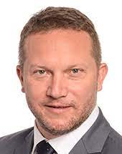
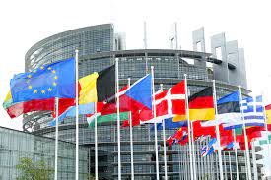
European Health Union: the first steps
At the pioneering initiative of the S&D Group, the European Parliament adopted a resolution (10 July 2020) on the EU’s public health strategy for the post-COVID-19 period: https://www.europarl.europa.eu/doceo/document/TA-9-2020-0205_EN.html
The EU Commission elaborated the concept and the first measures of the European Health Union, including the strengthening of the European Centre of Disease Control and the European Medicines Agency, the development of a new cancer control program.
The Commission launched a new European Health Emergency Preparedness and Response Authority (HERA) for health emergencies to develop, produce and procure medical countermeasures before and during a health crisis.
The pharmaceutical strategy aims to modernize the regulatory framework and support research and technologies that reach patients.
More details: https://ec.europa.eu/info/strategy/priorities-2019-2024/promoting-our-european-way-life/european-health-union_en

Slide 5

Slow progress in expanding European health competencies
The missing components (based on the S&D position paper):
Stress-testing of EU healthcare systems
A new Directive for Minimum Standards in Healthcare
Revision of the Transparency Directive for pricing and reimbursement of medicines
Full implementation of Cross Border Healthcare Directive and Clinical Trials Regulation
Legislative action on antimicrobial resistance and vaccination
European Health Data Space
A new approach to European health research
New legislation on health and safety in the workplace
Treaty change for a European Health Union as demanded by the Manifesto of European citizens: https://europeanhealthunion.eu/
Do the pandemic lessons lead to a wakeup call?

Slide 6
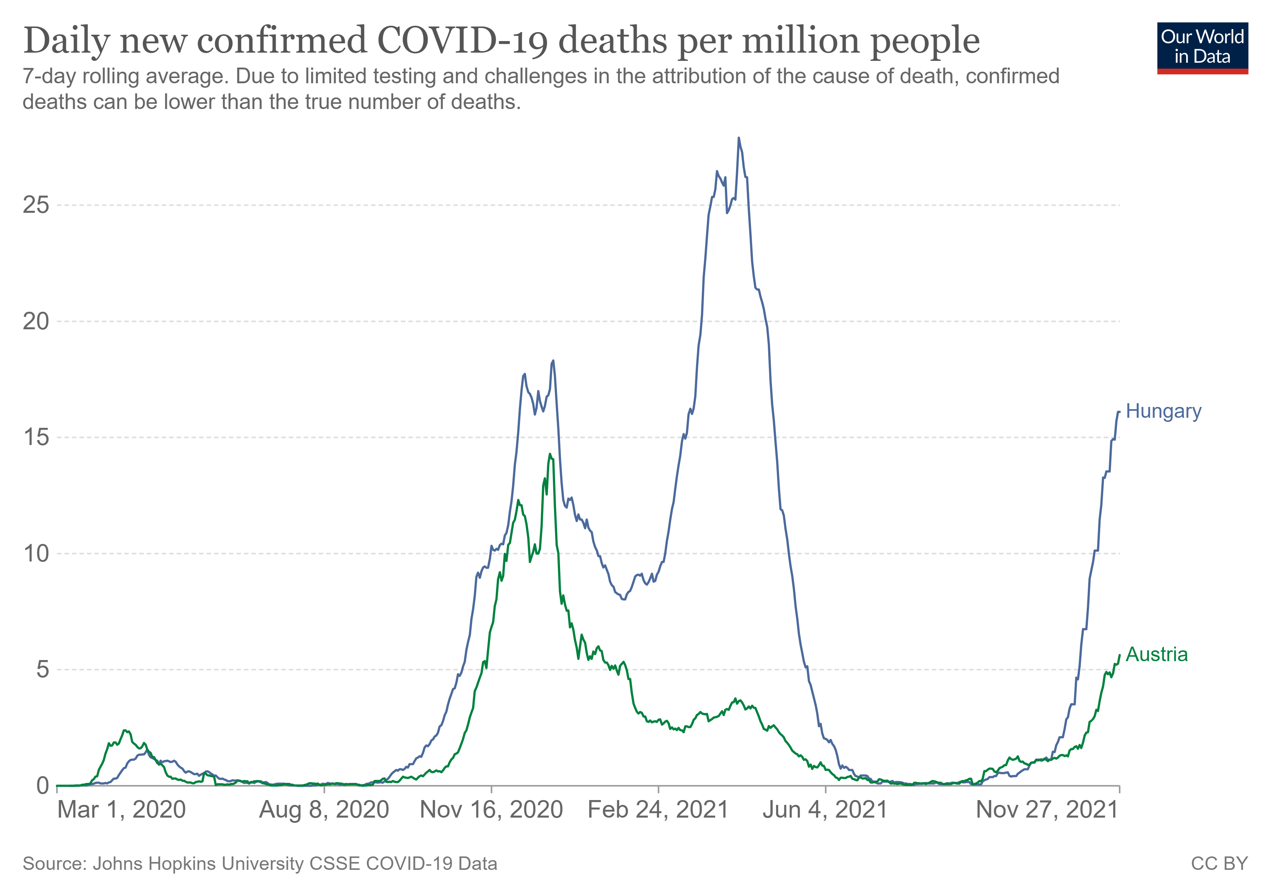
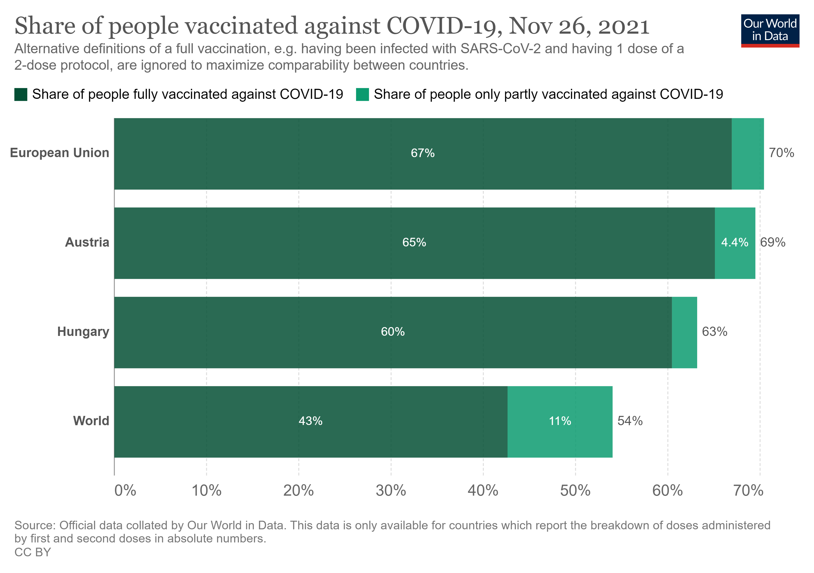
Pandemic response in the EU
EU failed to agree on common measures, mostly because of a legal framework that allows Member States to adopt unilateral measures in the case of an emergency
Huge differences in protection measures, e.g. AT: full lockdown and mandatory vaccination; HU: use of masks indoors, slight restrictions (29 November 2021)
Lack of trust and transparency between the countries, particularly with regard to enacting the International Health Regulations
Success stories: digital COVID certificate, joint vaccine procurement, transfer of patients from overcrowded hospitals (from IT, RO to DE)

Slide 7
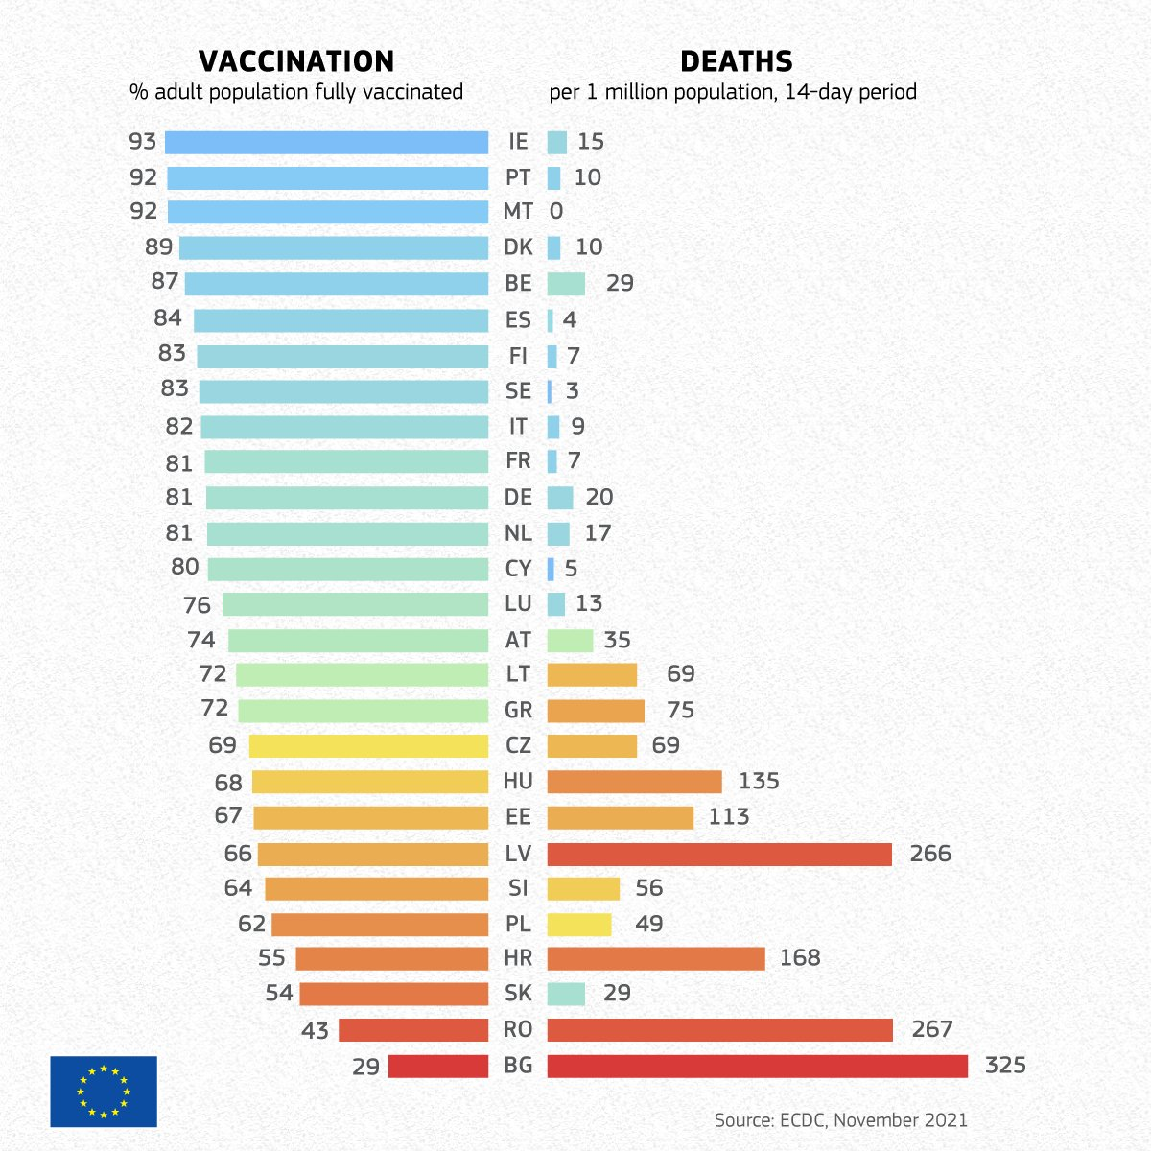
COVID-19: higher the vaccination rate, the lower the death rate

Slide 8
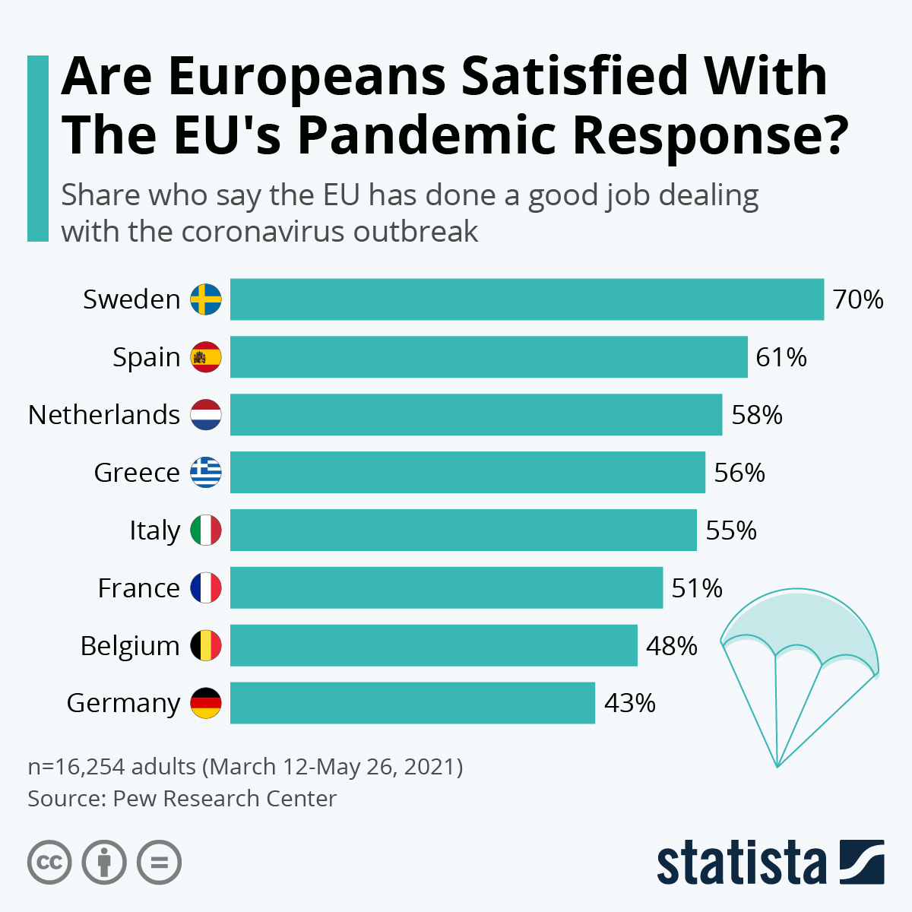
What would happen if the EU had stronger health powers in a public health emergency?
There would be no fragmented, country-specific, politics-driven pandemic response
Resources would be available to catch up with public health infrastructure in lagging MSs
There would be a common, unified reporting system in the 27 Member States
Pubic communication would be based exclusively on public health considerations
The introduction and extent of restrictive measures in regions would depend on epidemiological indicators such as the two-week average of the number of new COVID-19 cases and deaths per 100,000 inhabitants
Testing, contact-finding, patient care would be carried out according to evidence based protocols
Only vaccines approved by the European Medicines Agency could be applied

Slide 9
Hungary
Country Health Profile 2019
State of Health in the EU

Slide 10
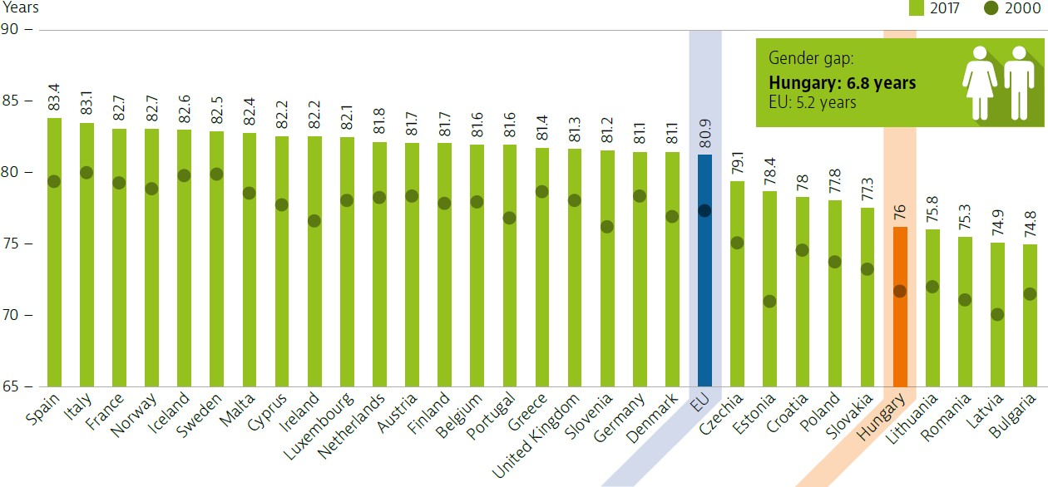
LE at birth in Hungary remains almost 5 years shorter than in the EU
Inequalities in life expectancy by gender and socio-economic status are also marked

Slide 11
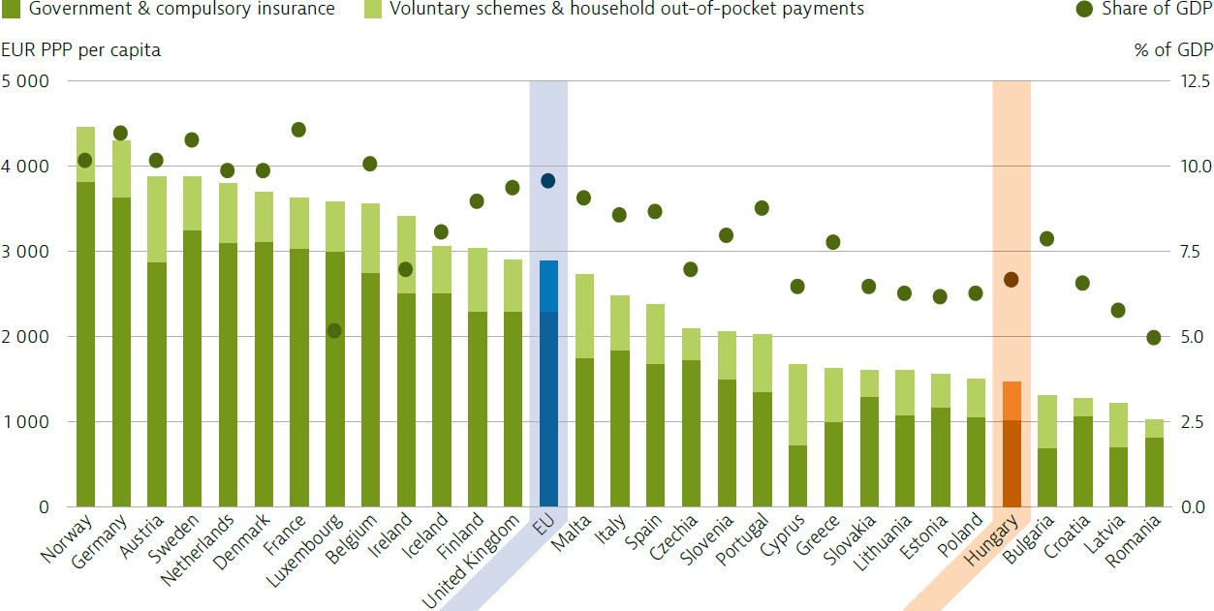
Hungary spends less on health care than most other EU countries
Health spending accounted for 6.9 % of GDP in 2017, well below the EU average.
The public share of health spending (government and compulsory insurance) accounts for only slightly more than two-thirds of total health expenditure.

Slide 12
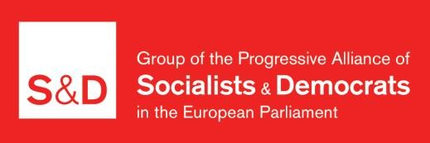


FEPS sponsored Hungarian research on the assessment of the European Health Union
In order to clarify the benefits of stronger EU health competencies and to assess which of the planned steps are considered important by Hungarians, an analysis was carried out based on
the responses to comprehensive policy questions by municipalities and professional organizations;
online consultations and webinar discussions with professionals, experts and policymakers;
telephone an online interviews with 2499 people (in December 2020) by the Publicus Institute and the Institute of Social Democracy on behalf of the FEPS

Slide 13
How satisfied are you with the state of the national healthcare system overall?
(All responders, %)
OVERALL
AGE
18-29
30-44
45-59
60+ EDUCATIONAL ATTAINMENT
primary at most
vocational high-school diploma
BA SETTLEMENT TYPE
Budapest
county capital
city township ACTIVITY
active retired
other type of inactive
-61
35
-50 45
-74
25
-59
36
-56
39
-57
37
-60
38
-62
35
-67
32
-56
42
-66
32
-60
33
-62
36
-63
35
-54
41
-66
28
-100
-50 0
rather dissatisfied
50
100
rather satisfied

Slide 14
Do you support the creation of the European Health Union?
(All responders, %)
OVERALL
AGE 18-29
30-44
45-59
60+
EDUCATIONAL ATTAINMENT
primary at most
vocational high-school diploma
BA
SETTLEMENT TYPE
Budapest
county capital
city township ACTIVITY
active
retired other type of inactive
-25
71
-32
66
-16
84
-15
80
-15
78
-14 76
-17
81
-20
79
-21
77
-24
72
-17
80
-17
79
-14
81
-19
79
-17
75
-16
83
-100
-50
rather no
0
50
rather yes

Slide 15
Do you agree that …? (All responders, %)
…it would be better if the European Union could have a say in how its member states run their healthcare systems, in order to improve their quality?
-38
60
…a minimum standard of healthcare is needed, that all
member states must provide for their citizens?
-13 87
…Hungary should spend significantly more on healthcare?
-12 88
… the European Union should establish a minimum amount that member states must spend on healthcare?
-35
64
-100 -80
rather disagree
-60 -40 -20 0
20 40 60 80 100
rather agree

Slide 16
If the health union would be realised, how would that change your
opinion about the European union? (All responders, %)
3
23
it would improve
41
it would rather improve
it would rather worsen
7
it would worsen
it would not significantly change
6
n/a
20

Slide 17

6 recommendations to be considered in the process of further developing the European Health Union
(based on the Hungarian study)
A five-year program and a timetable for the implementation of the European Health Union should be set up.
There is a need for a well-designed communication campaign which concentrates on the goals and benefits of the European Health Union.
It is worthwhile conducting research in several Member States based on a common methodology that clarifies, why the European Health Union is important for the population, professional and non-governmental organizations, and which measures should and should not be adopted.
Greater emphasis should be placed on disadvantaged groups - particularly in terms of their accessibility to care.
It is necessary to strengthen the EU’s commitment to disease prevention including rolling back the risk factors of NCDs.
Fiscal space should be created for the implementation of the components of the European Health Union in the EU budget as financing cannot be left to the MSs.

Slide 18
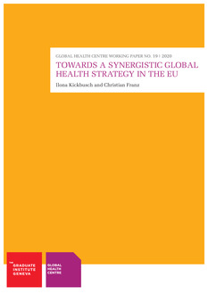
How can the European Health Union strengthen global health?
Synergies with WHO: the European Health Union could strengthen the role of the WHO in directing and coordinating the pandemic response (EU has been advocating for a binding pandemic treaty).
Compliance with WHO guidelines, contributing to vaccine development and distribution to LMICs can be easier if EU health competencies enhanced.
Setting safety standards that impact global health, in areas such as food safety, chemical safety, environmental policies and more recently also digital health has a spill-over effect beyond the EU.
As EU is the largest development donor of developing countries, the content of the Health Union influences the direction of financial and in kind assistance.

Slide 19
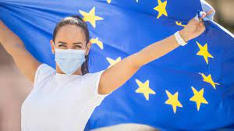
Concluding remarks
A European Health Union is already emerging and must be shaped by progressive forces, combining attention for national welfare arrangements with a strong commitment to fighting inequalities in health within a country as well as across countries.
The current public health crisis due to COVID-19 pandemic provides a chance to increase EU health competencies and persuade reluctant Member States to agree with it.
It is a public and professional expectation that minimum standards of quality care and the minimum level of health expenditures be defined.

Slide 20
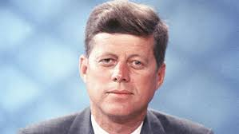
Take away message
„The problems of the world cannot possibly be solved by skeptics or cynics whose horizons are limited by the obvious realities. We need men who can dream of things that never were, and ask why not.”
John F. Kennedy
Address before the Irish Parliament in Dublin,
28 June 1963
Notes:
And one more last advice: follow your dreams.

